Slide 1
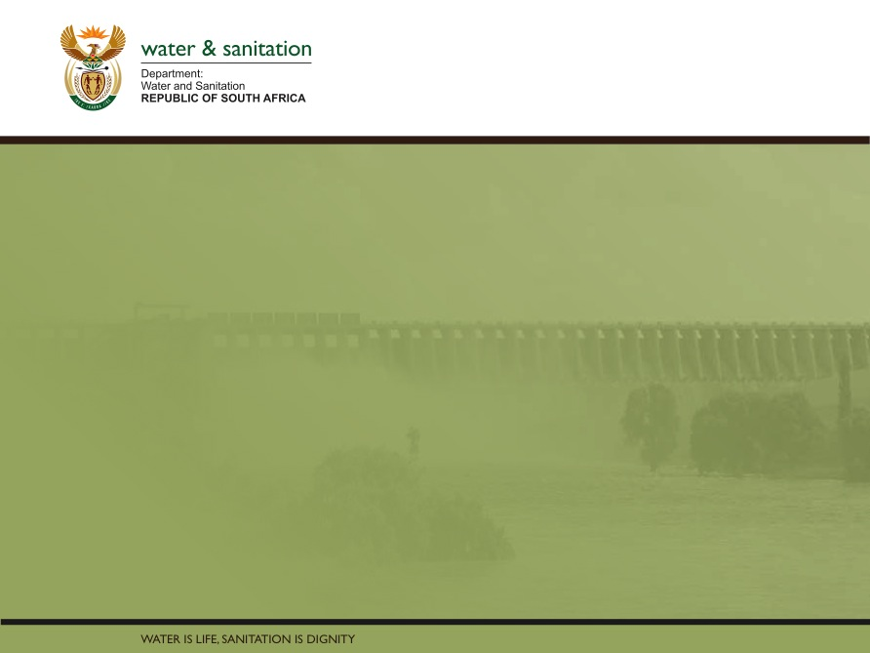

Determination of Water Resource Classes & Associated Resource Quality Objectives (RQOs) in the Mzimvubu Catchment
Presented by:
Lawrence Mulangaphuma
Department of Water & Sanitation
Date: 05 December 2016
PRESENTATION TITLE
Presented by:
Name Surname
Directorate
Date

Slide 2
Presentation Content
  Legal Mandate
  The Water Resource Classification System (WRCS)
  Study Focus: Determination of Water Resource Classes (WRC) & Resource Quality Objectives (RQOs)
  Study Area
  Process for the determination of Water Resources classes and Resource Quality Objectives & Progress to date
  Stakeholder Engagement Plan
  The role of Project Steering Committee members

Slide 3
Legal Mandate
Chapter 3 of the National Water Act (No. 36 of 1998), deals with the protection of water resources
The measures for protection of water resources are:
  Classification (S13)
  Reserve (S16)
  Resource Quality Objectives (S13)
S12 requires the Minister to establish the Water Resource Classification System, (WRCS)
WRCS was published as Regulation 810 in Government Gazette No. 33541 dated 17 September 2010
The WRCS defines:
  water resource classes and
  the procedure to determine Class, RQOs and Reserve
According to the NWA, once the WRCS has been gazetted all significant water resources must be classified and Resource Quality Objectives determined

Slide 4
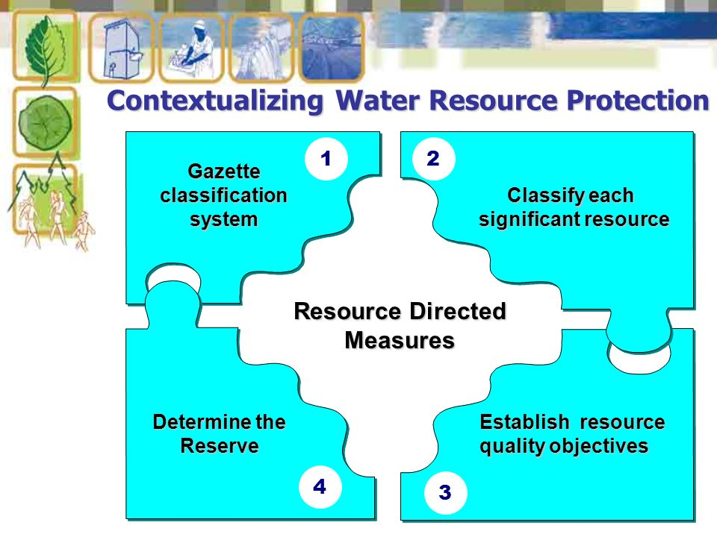
Contextualizing Resource Directed Measures

Slide 5
Determination of Water Resource Classes
Classification defines the desired state of the water resources by setting Water Resource Classes;
Each class represents:
    a different level of protection that is required for the water resource, and
    the extent to which the water resource can be used.
Classification is used in two ways:
    To describe the present status of the water resource
    To describe the state towards which the water resource needs to be managed sustainably (future state).
Surface water, groundwater, wetlands, estuaries
 | Description of use | Majority of ecological categories
Class I | Minimally used | A-B
Class II | Moderately used | C
Class III | Heavily used | D
Ecological Category (EC) - means the assigned ecological condition to a water resource . It is measured by determining how much the ecosystem has changed from natural (pre-development condition). The scale is A (near natural) to F (critically modified)
5

Slide 7
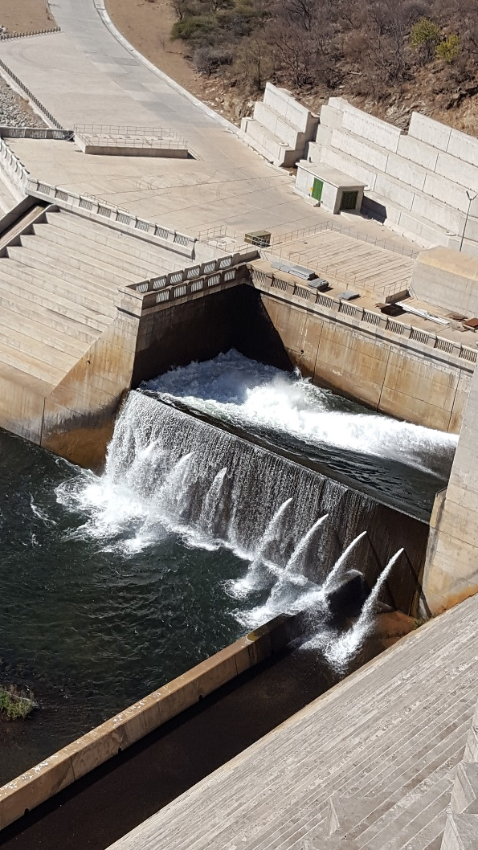

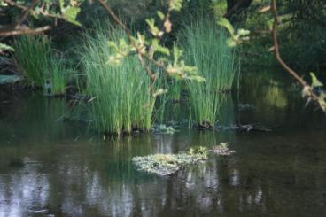
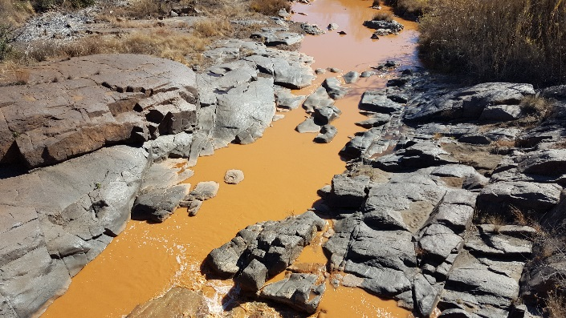


Determining Resource Quality Objectives
These objectives provide statements about:
    what the quantity of the water should be (water level, pattern, timing)
    what the water quality should be (physical, chemical and biological
    what the condition of the instream and riparian (river bank) habitat should be
    what the condition of the aquatic (water) animal and plant life should be.
Releases are looking good
This is perfect for me
HELP!!
7

Slide 9
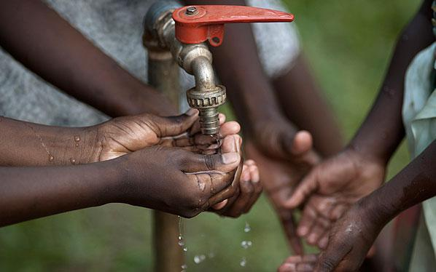
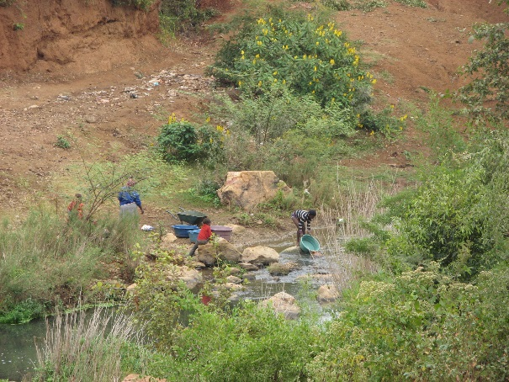
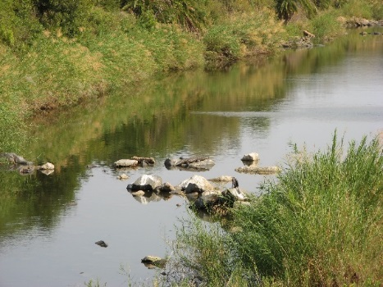
Determining the Reserve
The Reserve is an integral part of the resource quality objectives
The Reserve is part of the water resource within each water management area that is under the direct control of the Minister. It is water that is ‘set aside’ to:
    provide for basic human needs, and
    protect water ecosystems (sustain healthy ecosystems).
It has priority over all other water use. Water required for the Reserve must be met before water resources can be allocated to other water users
9

Slide 10
Study Focus: Determination of Water Resource Classes and Resource Quality Objectives
This study was initiated in August 2016 and will concludes in July 2018 (24 months)
The aim of this study is to co-ordinate the Determination of Water Resource Classes and Resource Quality Objectives in the study area
The determined WRC and RQOs will be gazetted once approved by the Director- General.

Slide 11
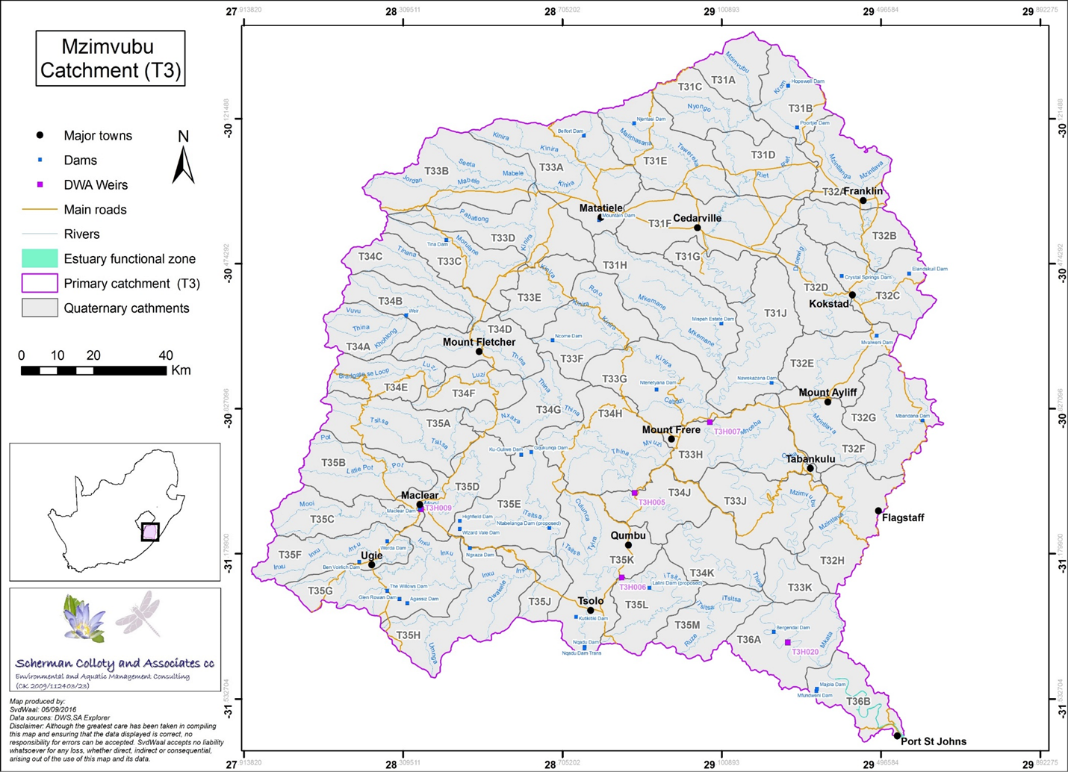
Study area

Slide 12
Implications of Classes, RQOs & Reserve
Once the Class is set, Reserve & RQOs in place, it is binding on all authorities or institutions when exercising any power, or performing any duty under the NWA.
The implementation of Gazetted Class, Reserve & RQOs may necessitate the Department to:
- Revise General Authorisations,
- Update Discharge Standards,
- Initiate Compulsory licensing,
- Update Monitoring Programmes

Slide 13
Main study tasks
Task 1: Inception
  Inception Report
  Stakeholder Identification and Mapping Report
Task 2: Information gathering
  Water Resources Information and Gap Analysis
Task 3: Determine Water Resource Classes
  Resource Units & IUA Delineation Report
  Status Quo Report
  Linking the Value & Condition of Water Resources
  Quantification of the EWR and changes in EGSAs
  Ecological Base Configuration Scenarios Report
  Report on Evaluation of Classification Scenarios
Task 4: Determine Resource Quality Objectives
  Resource Unit Prioritization Report
  Evaluation of Resource Units
  Outline of Resource Quality Objectives
  Monitoring Program to Support RQOs Implementation
  Confidence Assessment of Resource Quality Objectives
Task 5: Support Gazetting done by DWS to legalise
  Final Report and Gazette template
Current

Slide 14
Stakeholder Engagement Plan
Platforms | Stakeholder groups | Purpose
Project Steering Committee | Representatives from various Sectors | To give strategic inputs to the project
Technical Task team Meeting | Representatives from sectors with technical knowledge of study area and water resource management | To source comments and inputs on technical aspects of the project
Public Meetings | The broader public | To announce the project To present the proposed classes & RQOs
Forums | Catchment management forums | Information sharing
Sectors | Different sectors e.g. Domestic, Agriculture, mining etc. ( where necessary). | Information sharing

Slide 15
The Role Of Project Steering Committee (PSC)
Non-statutory, voluntary body.
Oversight body for water resource management within the catchment;
Provide strategic direction and guidance on the study process and tasks;
Serve as representatives of the stakeholder bodies and organisations and report back to them on an ongoing basis regarding the study decisions and results.

Slide 16
Proposed meeting schedule (1)
PSC meeting 1: 5 Dec 2016
Status quo assessment ; delineation of RUs + IUAs
Identification of priority areas, EWR sites and desktop biophysical nodes
PSC meeting 2: April 2017
Finalised spreadsheet of RUs, IUAs, drivers
Desktop and River EWRs, including EcoClassification results
Systems modelling
Selecting and defining operational scenarios

Slide 17
Proposed meeting schedule (2)
PSC meeting 3: August 2017
Estuary EWR results
Wetland EcoClassification
Groundwater report
PSC meeting 4: November 2017
Consequences of operational scenarios (estuary, river, economics, ecosystem services, user water quality)
Presentation of Preliminary WRC and RQOs

Slide 18
Further information
  For more information:
    Register on project specific web-site or email:
      https://www.dwa.gov.za/rdm/Documents.aspx
  For more information contact:
    Project Team: Patsy Scherman (patsy@itsnet.co.za)
    DWS (Pretoria): Lawrence Mulangaphuma (mulangaphumal@dws.gov.za)

Slide 19
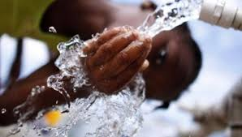
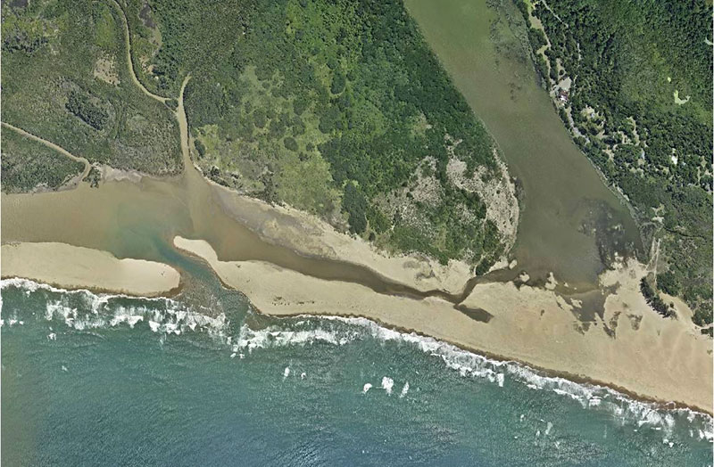
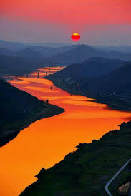
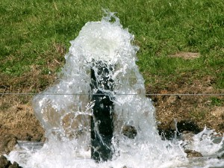
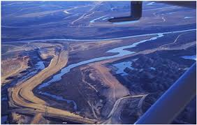
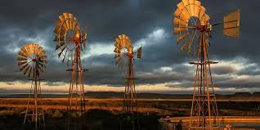
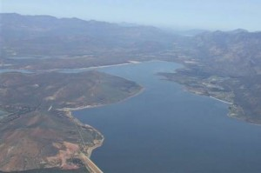


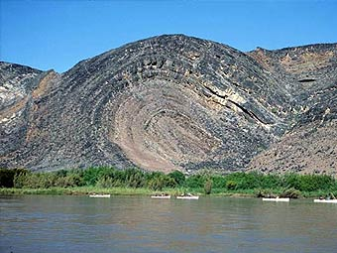

THANK YOU!
Estuaries
Rivers
Groundwater
Wetlands
Dams

